Slide 1



Slide 2



Introduction to MS Excel

Slide 3
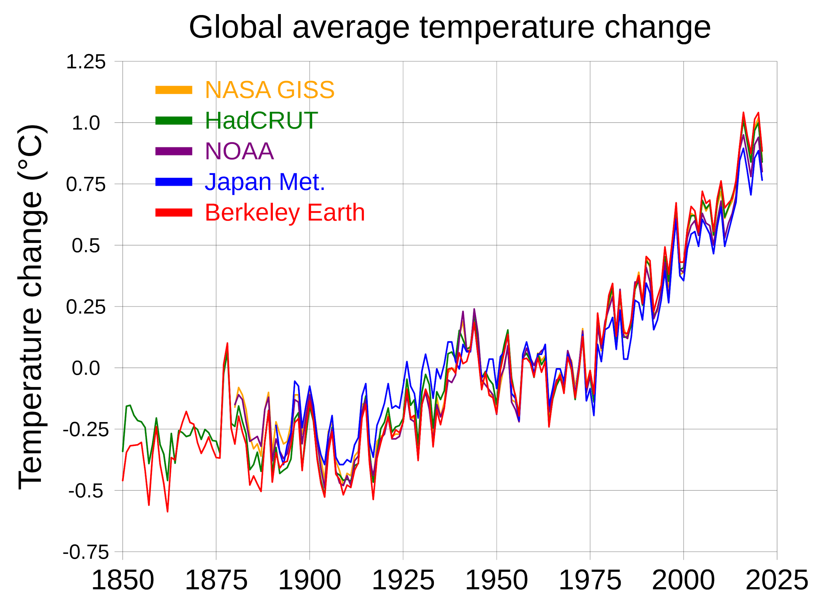


Why Excel Program?

Slide 4
Excel Workbook
A workbook is used to record & manipulate large amount of data including numerical info & share it with others in varied forms as we want.
Many other software are designed for the same purpose, like – Lotus 123, KOffice KSpread, Gnome Office Spreadsheet Gnumeric, etc.
But, we shall deal with the popular one - MS Excel

Slide 5
Topics We Cover
Why spreadsheet?
Getting started with Excel - Opening, Interface, Saving
Entering data - Intro to new terminology, text, numbers, dates
Modifying Excel sheet - Autofit, Wrap text, Inserting & deleting, adjusting width & height, hide & Unhide, Freeze, Filter & Sort
Formatting Data – Font, Background color, Borders, Merge & Center,
Using basic formulas & functions - Autosum, Formula arguments window
Creating Charts – Chart Ribbon, Modifying data in chart, Formatting a chart

Slide 6
Norms for the session
Eyes on the ppt for the instructions
Notice & listen to the instructor while I perform the task
Perform the task in your desktops
Takes turns in operating
Raise hands in case of any doubts
If your group is done please patiently wait for other to finish
After performing each task please notice the below
What is the task?
Steps & terminology involved
Connection between the task & the respective operating path in the ribbon

Slide 7
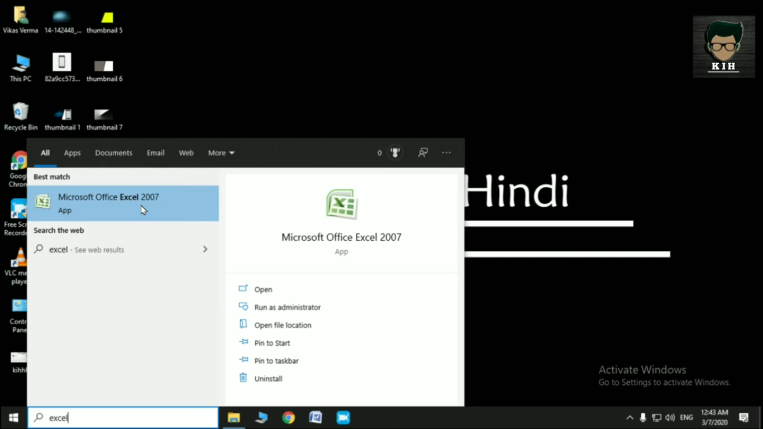
Getting started with Excel
Start > Programs/Apps > Excel > Open > Excel Interface
2
3
1

Slide 8
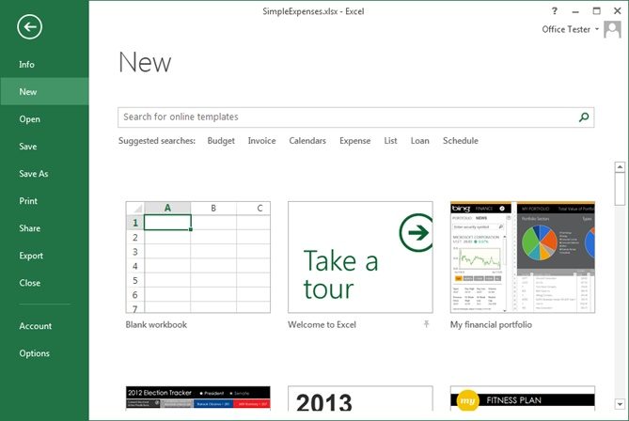
Open Word > in the left pane, select New > Select an option:
To create a new worksheet from scratch, select Blank workbook.
Notes:
Workbooks

Slide 9
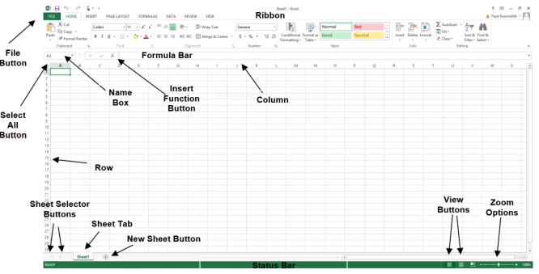
Excel Interface

Slide 10
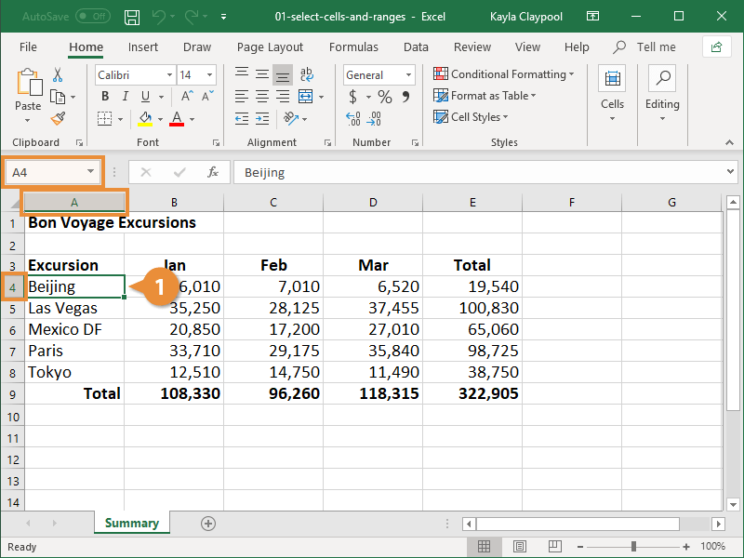
Cell

Slide 11
References
4
2
3
Notes:
Active cell and cells

Slide 12
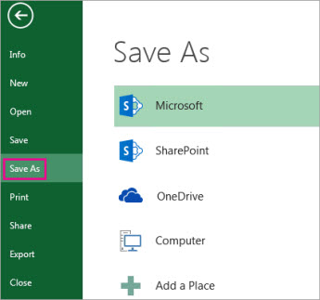
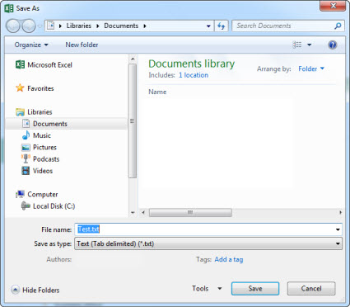
Save the workbook – Save & Save As from File Tab. Save – To store the current open workbook as a file. If the file has not been saved yet, prompts for a filename. Same as Quick Save. Crtl+S. Save As – To store the current open workbook with a new name or location. File Extension (basic) - .xls or .xlsx
1
2
1
3
3

Slide 13
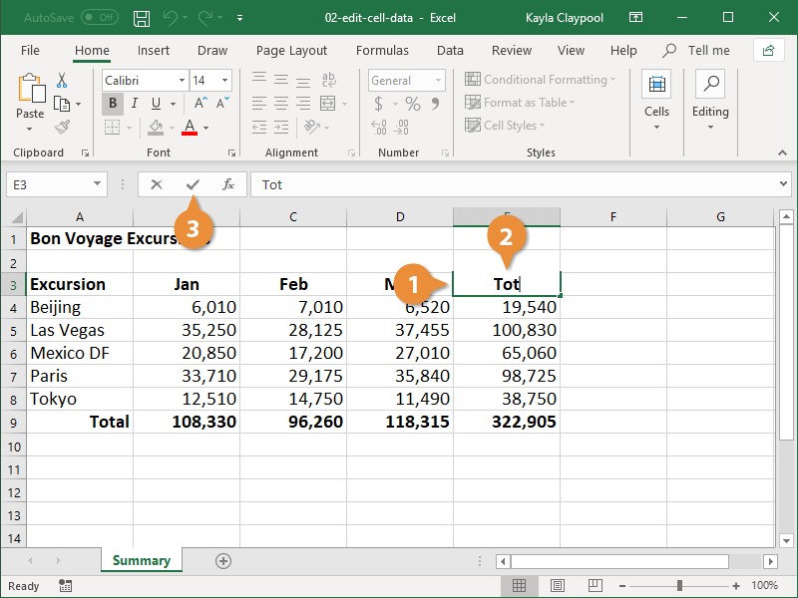
Entering Data
Text & Numbers:
Notes:
We can write different data in excel like text , numericaldata, dates, currency..etc by default text is left align.and numerical data is right align.

Slide 14
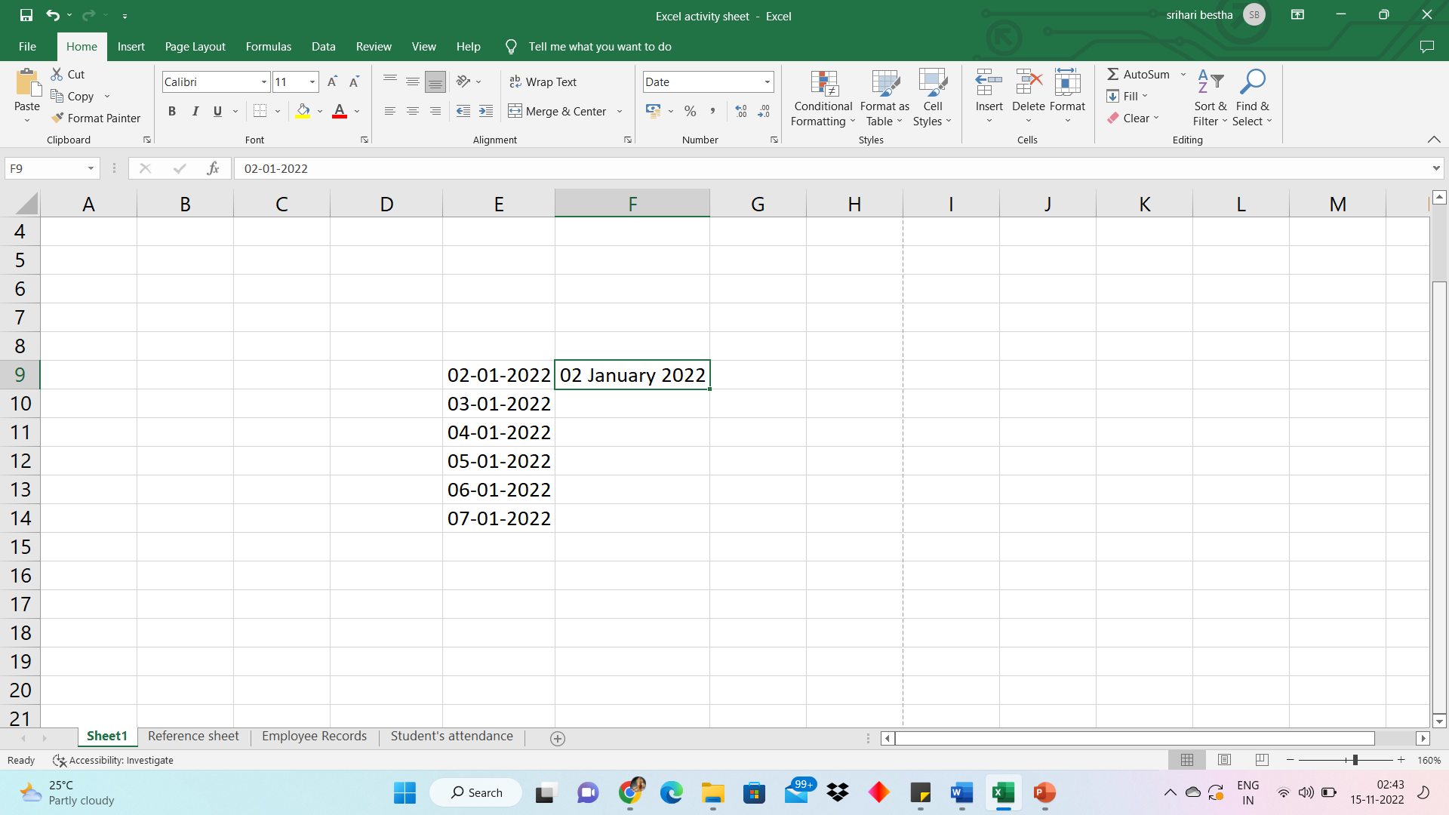
Entering Data
Dates: Slide change

Slide 15
Navigating & Selecting Data
Use Ctrl + arrows to move wide across
Home > Editing > Find & Select
Hold & drag => Select the range
Hold Ctrl + select cells individually – selecting non-adjacent cells
Use Shift + Ctrl + arrows to select wide ranges
Notes:
Navigation- movement(moving from one to other cells) Click ctrl +arrows to move from one data to end of another data another data<-....-> Ctrl+f to find 3D plus is used to select the data and dragging.(the selected data cells is called range). Press shift and ctrl to select the full content but before see were your curser is placed.

Slide 16
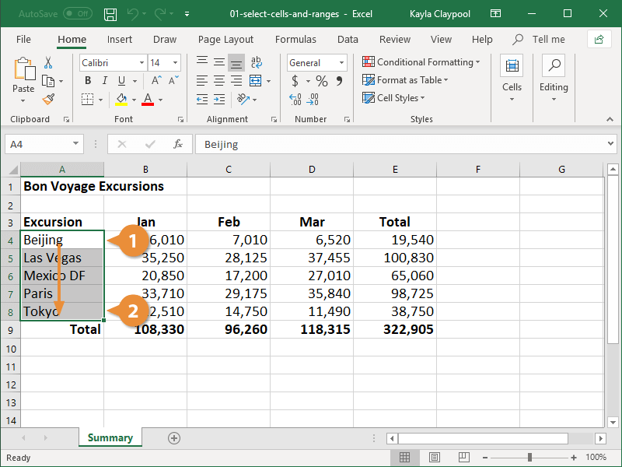
Range - Cells
Notes:
Selecting of more than one cell is known as range it can be from rows /column/cells.

Slide 17
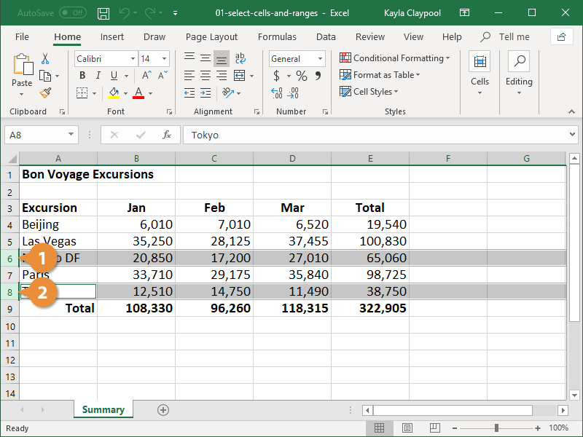
Selecting Non-Adjacent Cells
Ctrl + Cells/ Rows/ Columns

Slide 18
Modifying Excel Sheet
Cut, Copy & Paste, Swap
Clipboard & Paste options
Adjusting width & height, Autofit, Wrap text
Inserting & Deleting
Hiding & Unhiding
Freeze & Unfreeze
Sort & Filter
Notes:
Exchanging of data between ranges and cells is known as swap. Autofit:double click on the column line

Slide 19
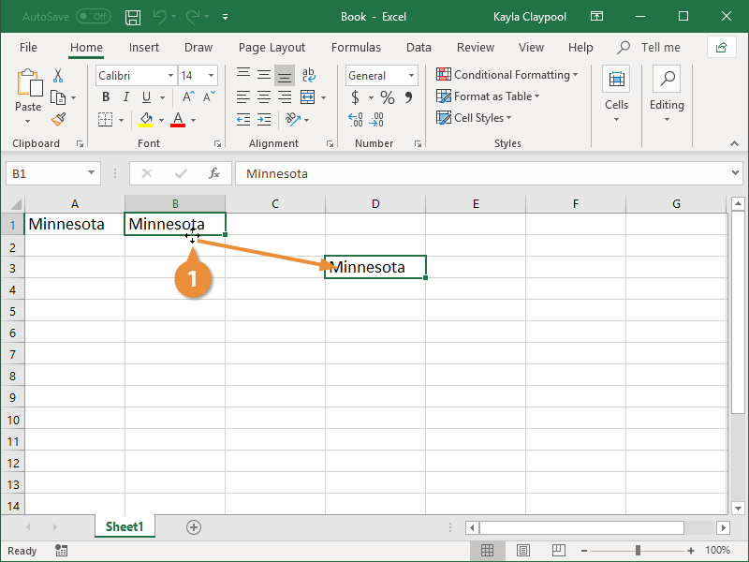
Drag & Drop
2
Notes:
Dragging data by draggin the plus at the corner. Paste-copy the content and paste if you want to change the width click on ctrl option and select the changes required. Transpose in past:mean, median, mode. Format: only change the format no content is added. In the box.

Slide 20
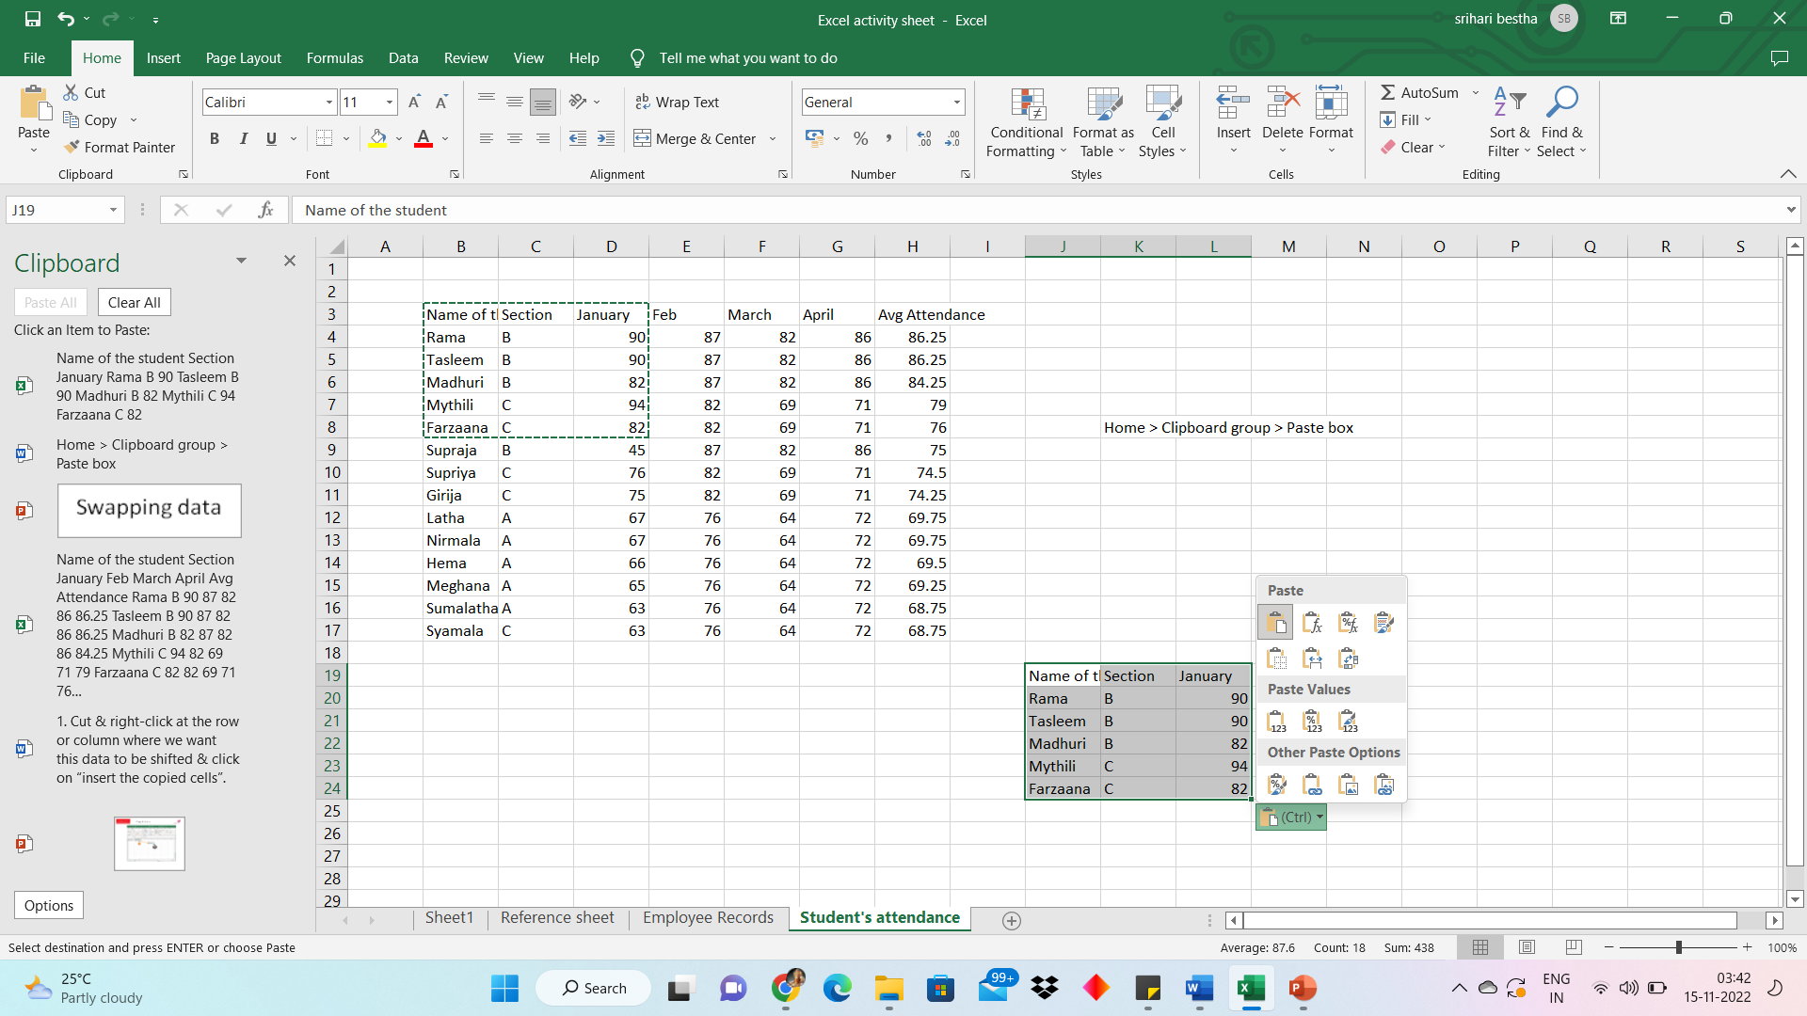
Exchanging of data between ranges and cells is known as swap.
Swapping data
Cut & right-click at the row or column where we want this data to be shifted & click on “insert the copied cells”.
Paste options icon
Paste – keep source formatting
Paste – Keep source column width
Paste – transpose
Home > Clipboard group
2
1
Notes:
swap:Exchanging of data between ranges and cells is known as swap. Select the number or text click ctrl +x at one side and other slide select the content and right click and you can see the option called insert cut sell the swap will take place.(right to left)

Slide 21
Modifying Excel Sheet
Adjusting width & height, Autofit (Changes cell size to content size), Wrap text (Changes content size to cell size)
Inserting & Deleting
Hiding & Unhiding
Freeze & Unfreeze
Place your cursor at the cell above which rows & columns should be kept in freeze > Select View tab > Window Group > Freeze Panes
Sort & Filter
Home tab > Editing Group > Sort & Filter

Slide 22
Formatting Data
Color
Font
Background color
Borders
Merge & Centre
1
2
3
4

Slide 23
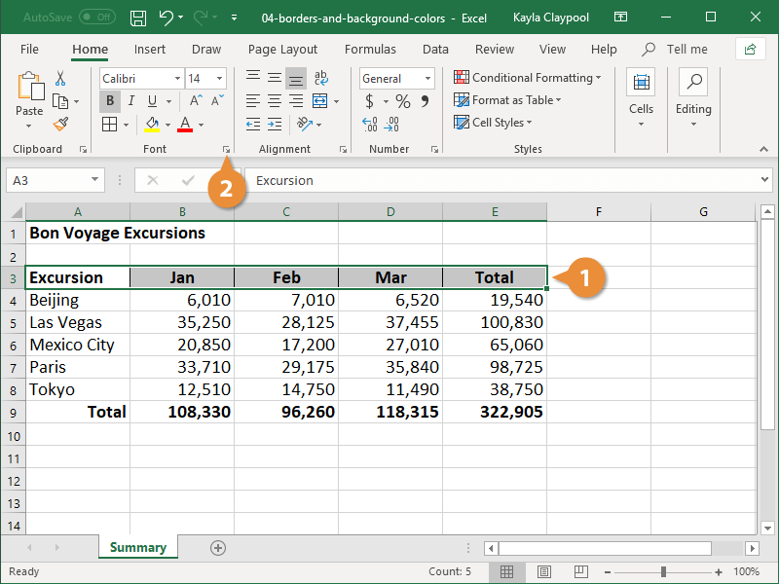
Font

Slide 24
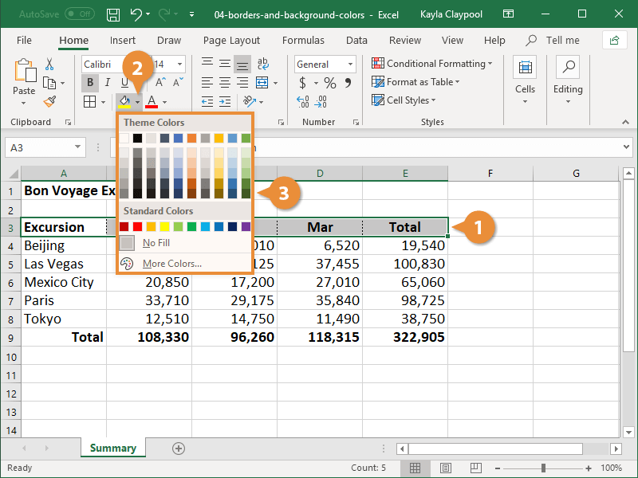
Background Color

Slide 25
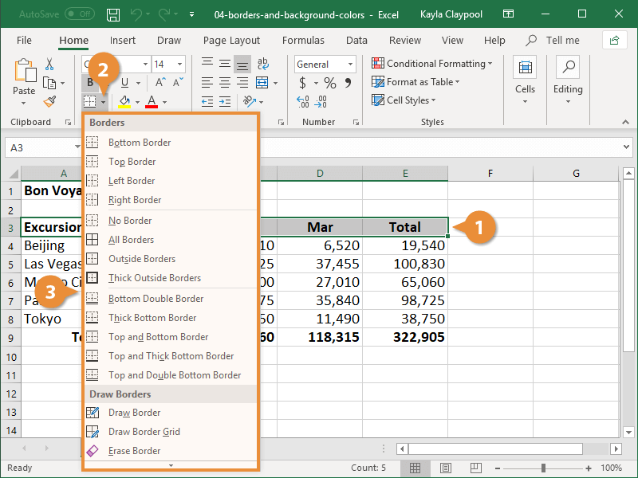
Borders

Slide 26
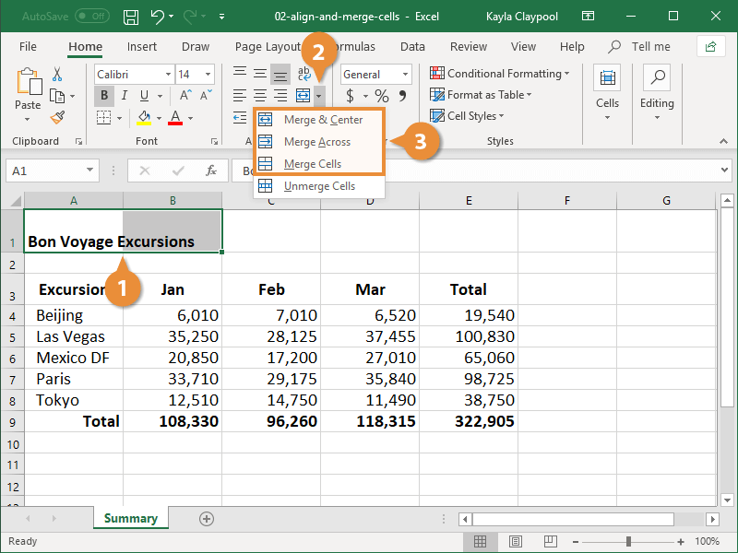
Merge & Centre

Slide 27
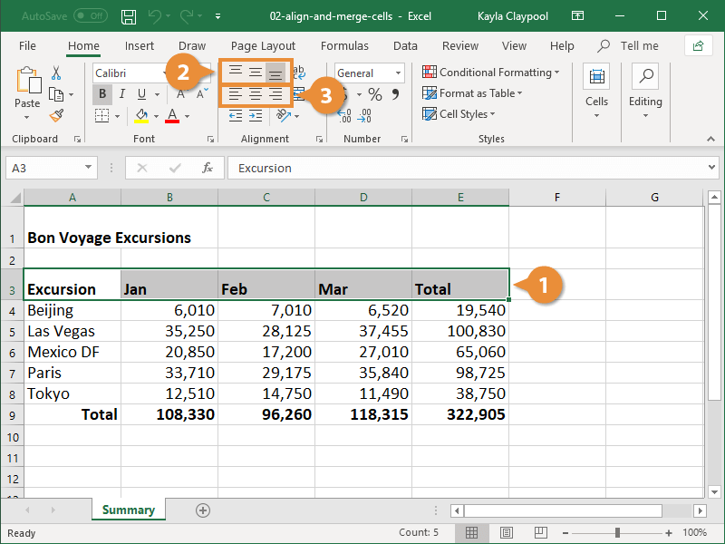
Alignment(Centre)

Slide 28
##Formulas##

Slide 29
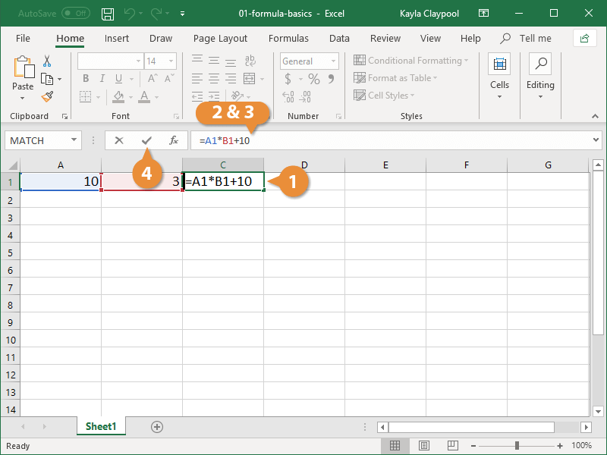
Formulas:

Slide 30
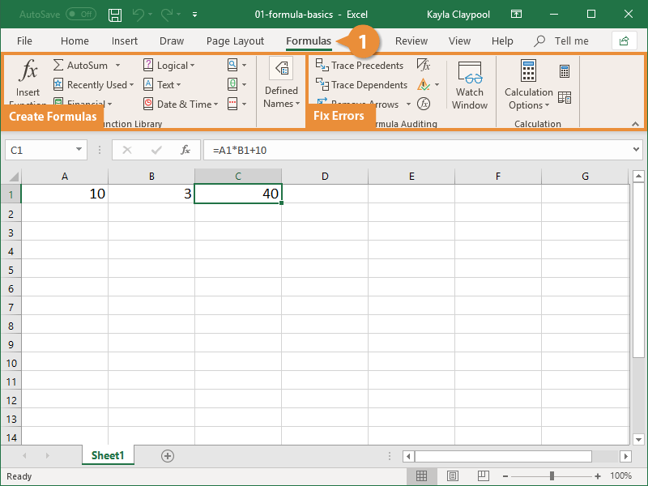
Other Options:

Slide 31
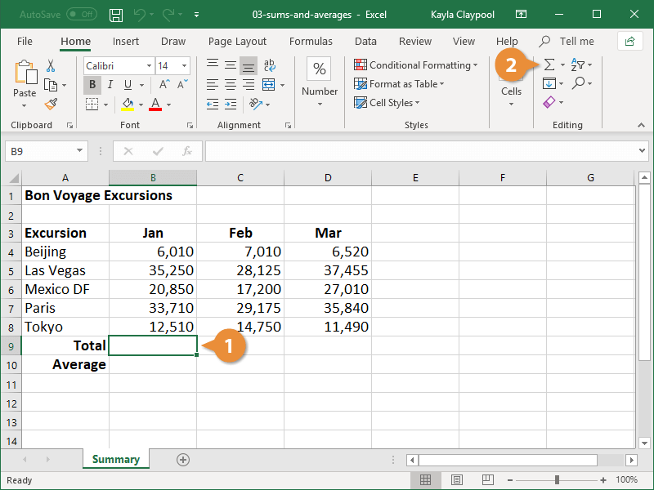
SUM Formula_ Step-1

Slide 32
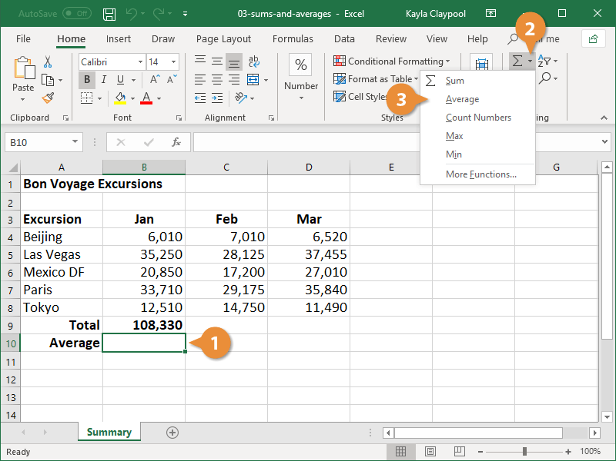
AVG Formula_ Step-1

Slide 33
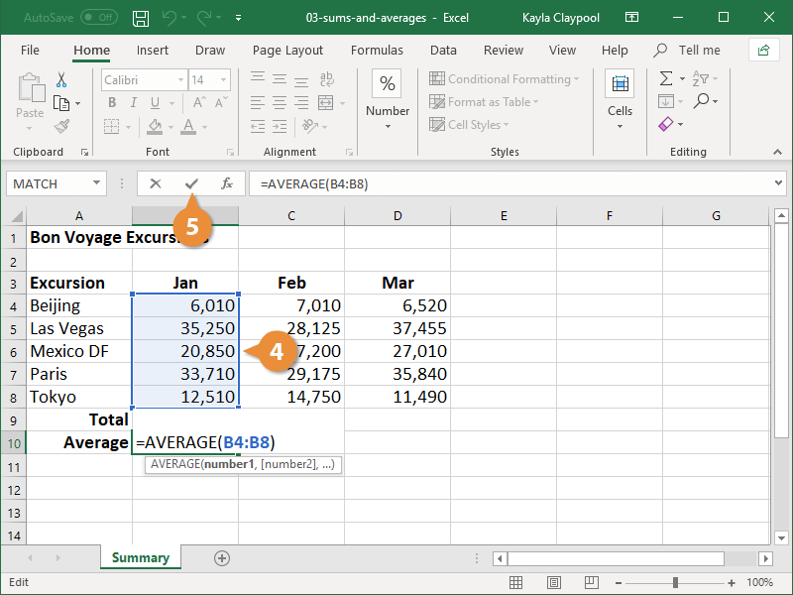
AVG Formula_ Step-2

Slide 34
Relative Vs Absolute references:
Relative References | Absolute References
Cells in Relation | Refer to Same cells.
When moved refers different cells. | Same cell reference even after movement
Default type reference | Dollar signs in formula
Eg: A1 | Eg: $A$1

Slide 35
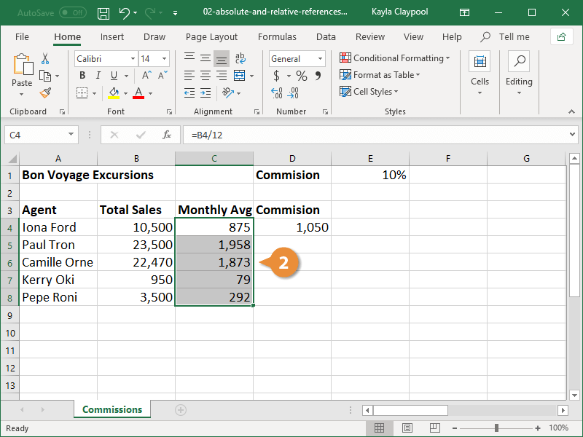
Relative references Part-1:

Slide 36
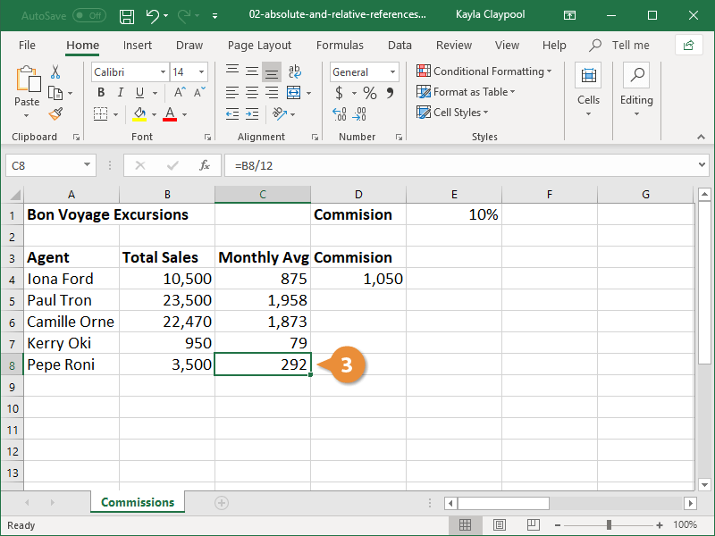
Relative references Part-2

Slide 37
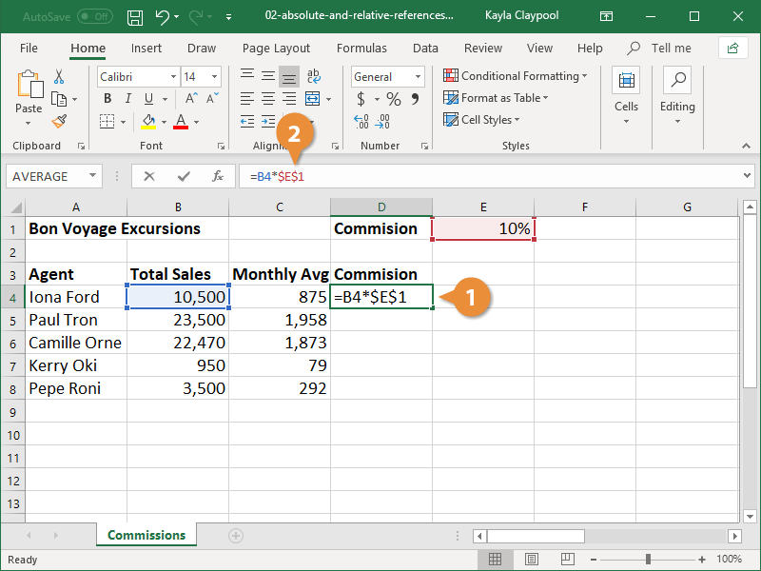
Absolute references:

Slide 38
Creating Charts
Chart Ribbon
Modifying data in Chart
Formatting a Chart

Slide 39
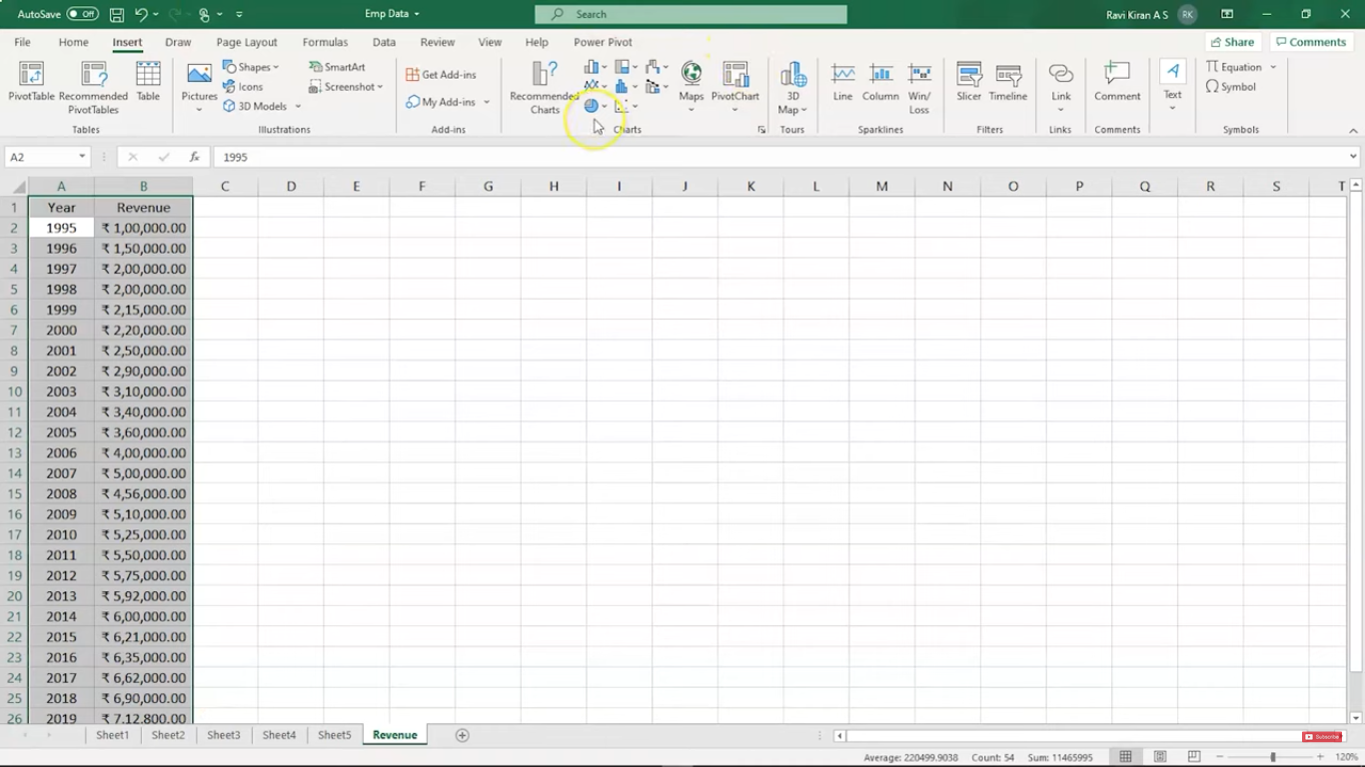
Chart Ribbon
1
2
3

Slide 40
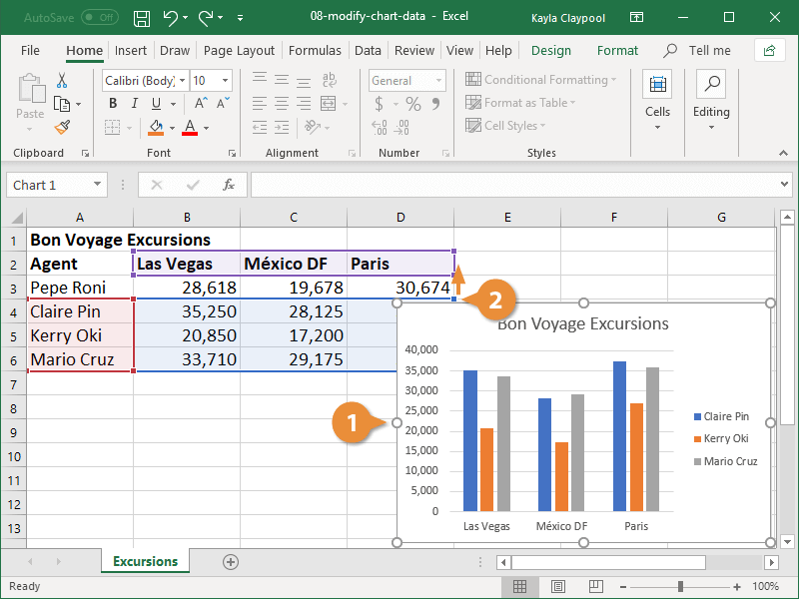
Modifying data in Chart
Adding data

Slide 41
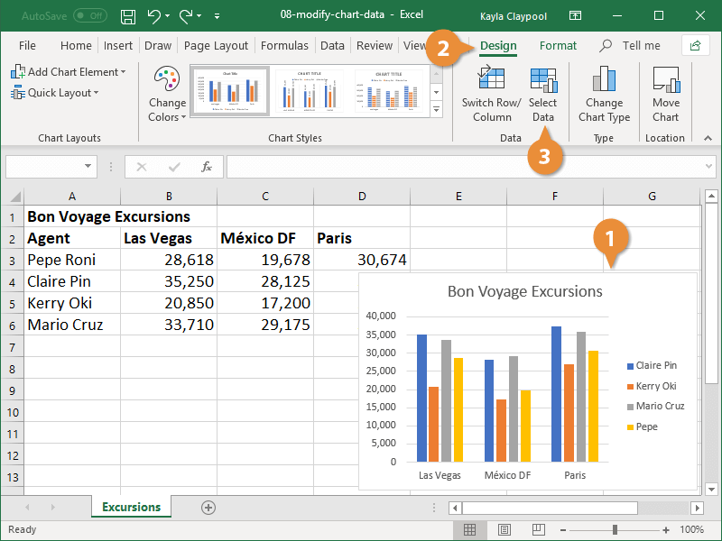
Modifying data in Chart
Re-ordering Data series

Slide 42
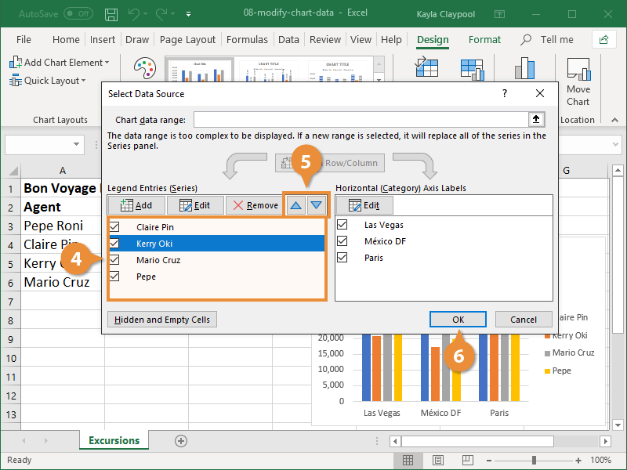
Modifying data in Chart

Slide 43
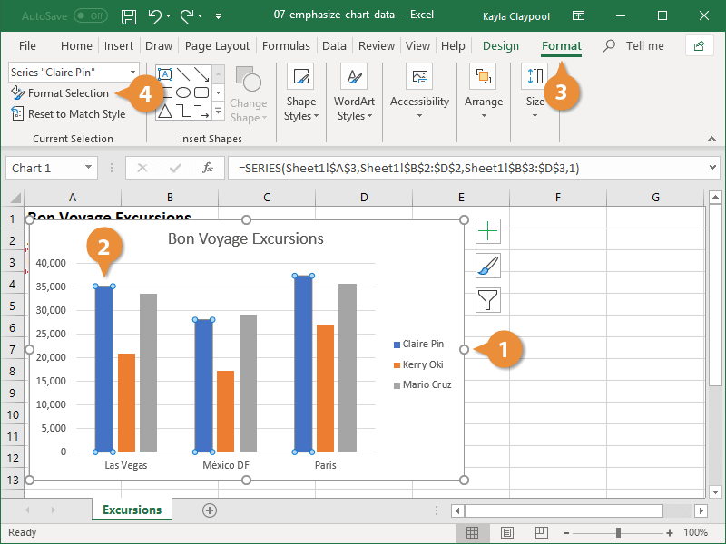
Formatting a Chart
Color

Slide 44
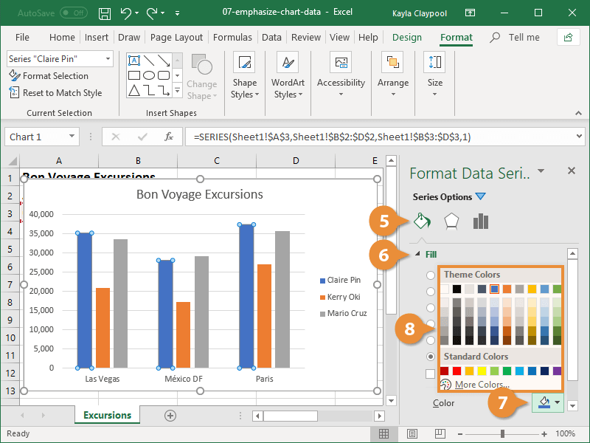
Formatting a Chart
Color

Slide 45
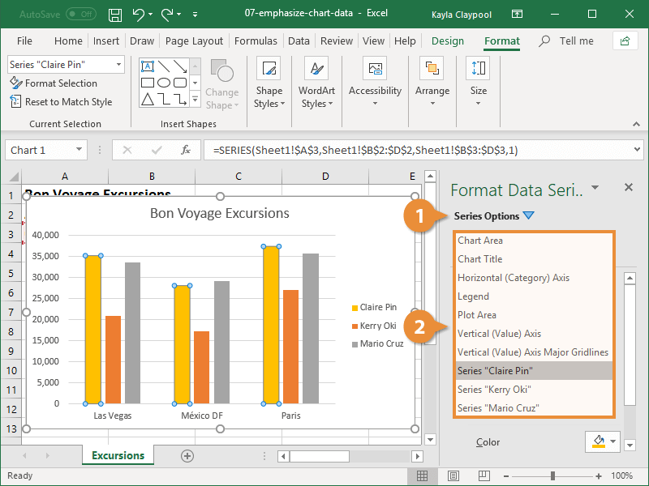
Formatting a Chart
Other

Slide 46
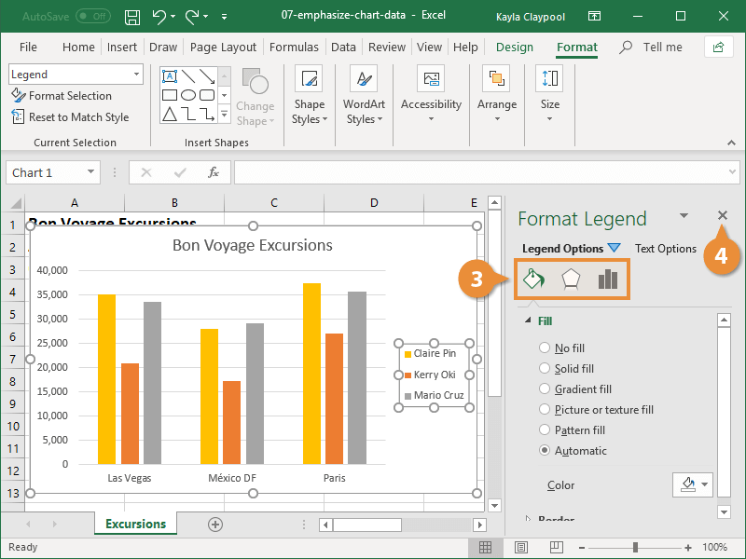
Formatting a Chart
Legend

Slide 47
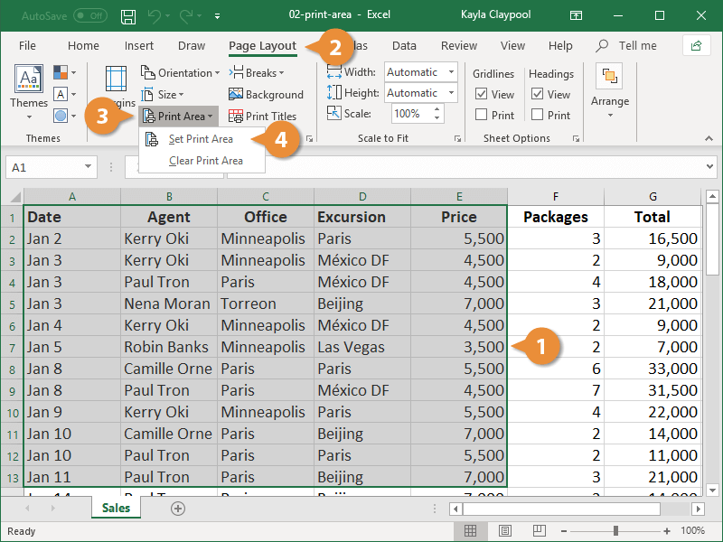
Printing the Sheet

Slide 48
Home work
J

